Slide 1

Data Analyst Job MARKET
Website Development
Project 3
10/9/21
Notes:
Cody
What does a data analyst do? The data analyst manipulates and analyzes large sets of data to help grow the companies’ revenue or reduce costs. They can take the data that they have analyzed and transform it into charts or graphs to make it presentable to the stakeholders. Data Analysts are a very important asset to any company because of the abundance of data that is now accessible to the world. We decided to analyze the job market for Data Analysts because of the importance of the role as well as the strong job outlook.

Slide 2




Meet The Team
MICHELLE DAVIS
YUQING HUANG
DAWN WASHINGTON
CODY GARDNER
Notes:
Cody
As you can see here, this is an overview of the team with all our photos. List out the names of the group.

Slide 3

Introduction
Technologies/Data Source
Project Overview
Development Process
Website
Q&A
Notes:
Cody
This slide is a layout of the project. We will go over the technologies as well as the data sources that we used to pull the data. Our team will provide a brief overview of the project as well as talk through how we cleaned up the data, created an ETL pipeline and created graphs from the data. We will also walk you through the website and show you the different interactive graphs that we created. At the end of the presentation, we will have time for any questions that you might have.

Slide 4

Introduction
So You Are Looking For A Data Analyst Job?
The pandemic resulted in many people losing and looking for jobs. The Data Analyst Job Search Website makes it possible to target your job search based on:
Location
Salary
Sector
Notes:
Cody –
The purpose of this project is to analyze the factors which impact salaries in the field of data analytics and to use this information to create a website to assist job seekers in their research.It’s no secret that the coronavirus 2019 (COVID19) outbreak is deeply affecting the lives of millions around the world, both directly and indirectly. The United States alone has shed nearly 10 million jobs in the past two weeks due to the COVID-19 shutdown. Even though the job market might look bleak in some industries, the job market for data analysts is doing great right now with the expected job outlook to increase by 10%. We have created a website that precisely helps people look for data analyst jobs nationwide. Our website lets users get whole picture of data analysts job openings nationwide, including size of employer, location, industry and estimated salary range.

Slide 5







Technologies/Data Source
Kaggle Dataset – Data Analyst Jobs
2253 job listings scraped from Glassdoor
Created 7/14/2020
Notes:
Dawn –
Slide 5 For our website, we used a data analyst dataset from Kaggle, containing salary ranges, location, company rating, job description and more for data analyst jobs in the United States. Glass door was the source of the data which was created in 2020 – during the pandemic. Our dataset had more than 2000 rows and 16 columns. While going through our data we decided to focus our visualizations around job opening by location, employer's size and estimated range of salary.
## Application: Python (Jupyter Notebook, Pandas) JavaScript Libraries (Plotly, Leaflet) HTML/ CSS Excel
Postgres SQL

Slide 6

Project Overview
Clean the Kaggle Dataset
Create Visualizations – Python, Plotly
Create Webpages - HTML/CSS
Load Website - GitHub Pages
Let’s Dive In
Notes:
Dawn
A brief overview of how we approached the project. We cleaned the Kaggle Dataset. Created Visualizations using Python and Plotly. Created Webpages using HTML/CSS. Finally, we loaded the website on to Github Pages.

Slide 7
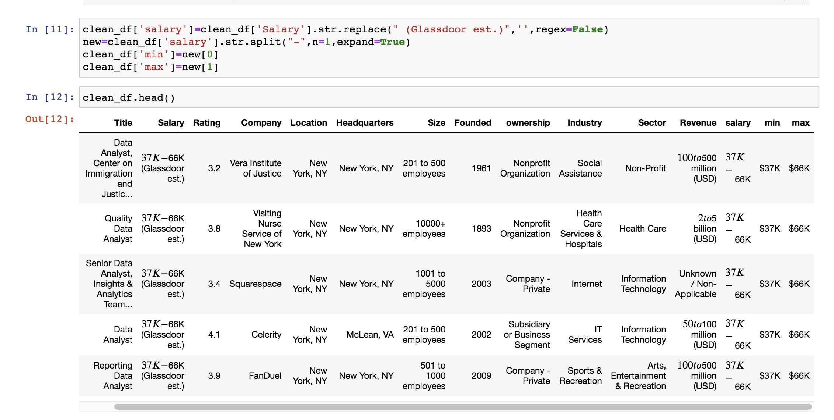
Data Cleaning
Notes:
Yuging –
we imported the csv file into Pandas and then prepared for dataset. First we check and detect if there is any missing value. Most of the time in the real world datasets, unknown and missing values are not easy to be recognized. when we explored dataset, we found there were -1 as value of rating, company. so we define str (-1)s and numeric and float types of (-1)s as missing values. and we recheck missing values in our dataset and deleted all of N/A.After we were good with that, we realized even though we have information about the salary ('Salary Estimate'), it is not in the numeric type,same for 'Size' and 'Revenue'. We need to get rid of those $ and K signs, convert object type into numeric value and change range into min, max, to make our analysis more compatiable.To do that, we used method of string.split and string.replace.To get dataset into SQL and json file, we had to changed type of rating from decimal into varchar. because decimal object is not json serializable.

Slide 8
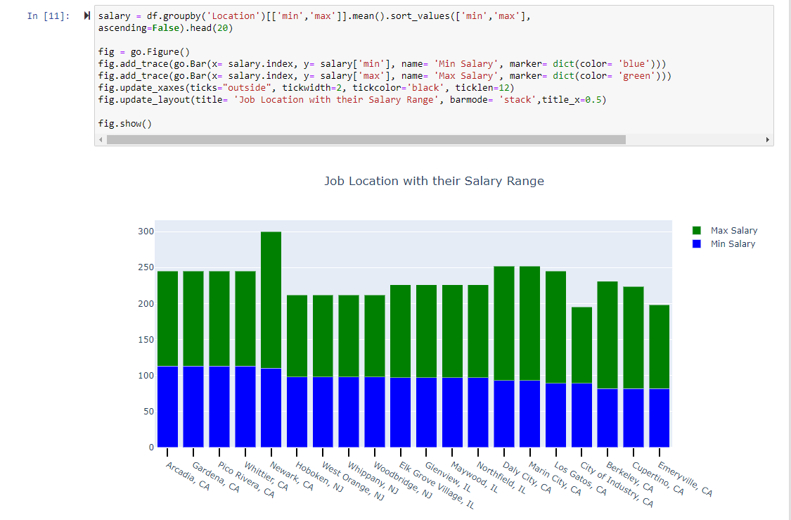
Create Visualizations
Notes:
Yuging
Use python in jupyter notebook to gain insights into the data before creating website. We were able to gather various insights from the data which we displayed in the webpage.

Slide 9
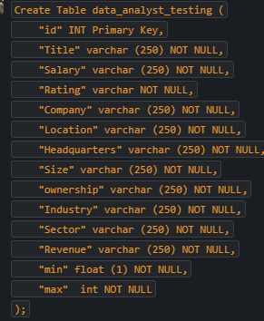
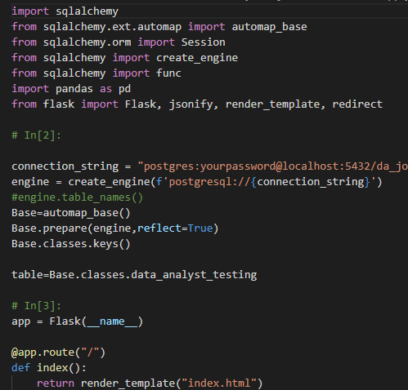
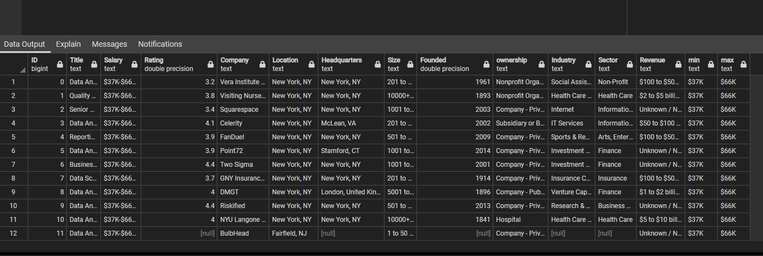
Create Database
Notes:
Yuging
After exploring the data we transform and loaded into data base.

Slide 10
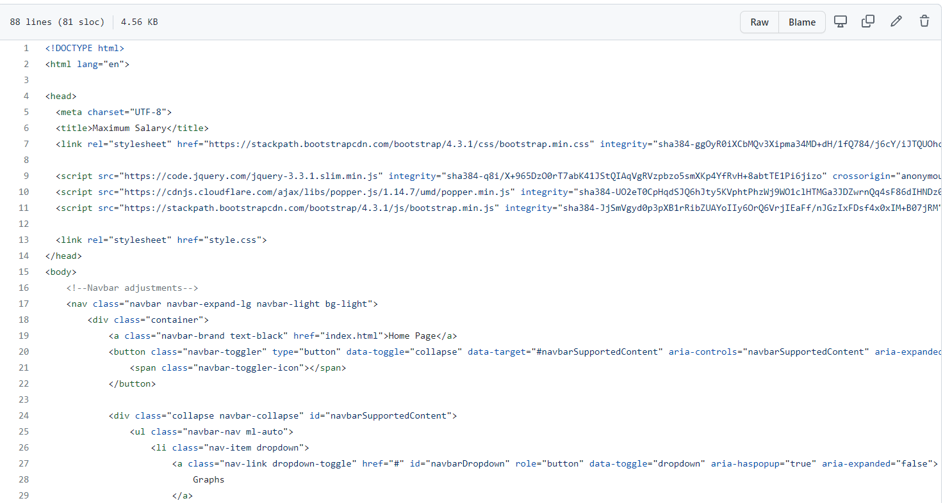
Create Webpages
Notes:
Once we completed the EDA we gained insights for what we wanted to show on the website. And after ETL we created a website. Here you can see the html and css code. The insights gained were salary by location, Job titles, Sectors and Industries hiring and salary distribution for example.

Slide 11
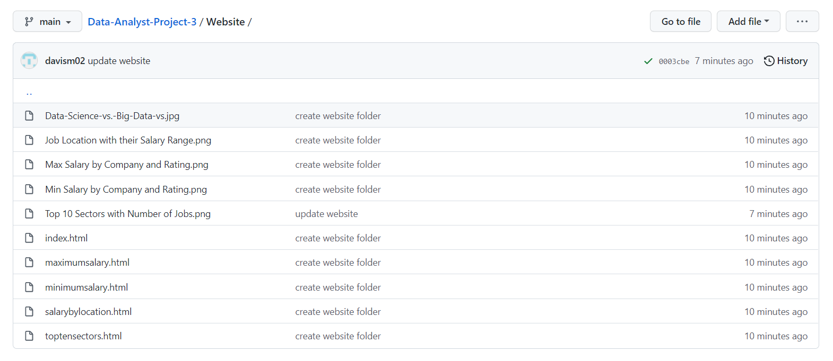
Deploy GitHub Pages
Notes:
After the website was created we deployed it to git hub pages

Slide 12

Data Analyst Job Market
https://davism02.github.io/Data-Analyst-Project-3/Website/index.html
Notes:
We also have the QR code so you all feel free to scan and go to our page. We will now go to the webpage.

Slide 13

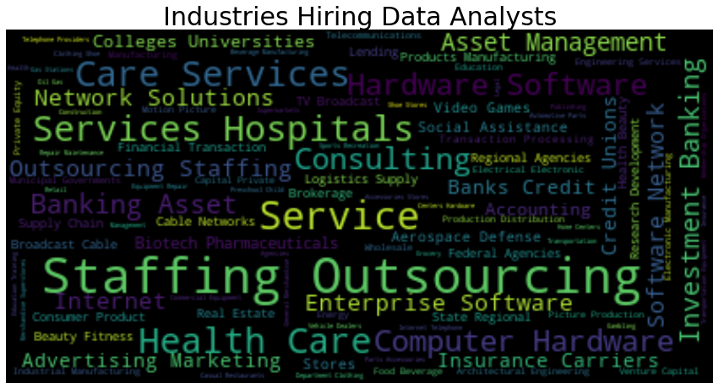
Notes:
Finally , Industries for data analystStaffing outsourcing industries, Health care, hospitals, Consulting, Insurance, to name a few. As we have shown from the website there are lots of places for a data analyst to go.

Slide 14
Q&A

